Slide 1
Digital Portfolio
STUDENT NAME: JAGAN.M
REGISTER NO AND NMID: 212400941/D8B468B305BC37586344E74BB0DBFE0F
DEPARTMENT: 2BCA
COLLEGE:Prince Shri Venkateshwara Arts and Science College/University of Madras

Slide 2
Personal Portfolio Website

Slide 3

AGENDA
Problem Statement
Project Overview
End Users
Tools and Technologies
Portfolio design and Layout
Features and Functionality
Results and Screenshots
Conclusion
Github Link
3/21/2024 Annual Review

Slide 4

Many students and beginners struggle to showcase their skills and projects effectively.
Traditional resumes lack interactivity and real-time updates.
A personal portfolio website solves this by providing a professional online presence.

Slide 5

This project is a responsive portfolio website designed to highlight:
Personal information
Contact details
Skills and technologies
Projects and achievements
The goal is to provide a professional platform to represent myself digitally.

Slide 6

Recruiters / Employers – To evaluate my skills and projects
College Faculty – For academic/project assessment
Peers / Collaborators – To connect for project collaborations
General Audience – Anyone interested in my work

Slide 7
HTML5 – Structure
CSS3 – Styling & Layout
JavaScript – Interactivity
React – For scalable frontend design (future scope)
GitHub – Code hosting & version control

Slide 8
Header: Name, Education details
About Me Section: Personal introduction
Contact Section: Email, phone, LinkedIn
Skills Section: Technical expertise
Projects Section: Ongoing & future work
Footer: Copyright
Design follows a clean, minimalistic, and responsive layout.
‹#›

Slide 9
✅ Responsive design (mobile & desktop friendly)
✅ Organized layout for skills and projects
✅ Contact details with LinkedIn link
✅ Easy to update for future projects
✅ Simple and user-friendly interface

Slide 10
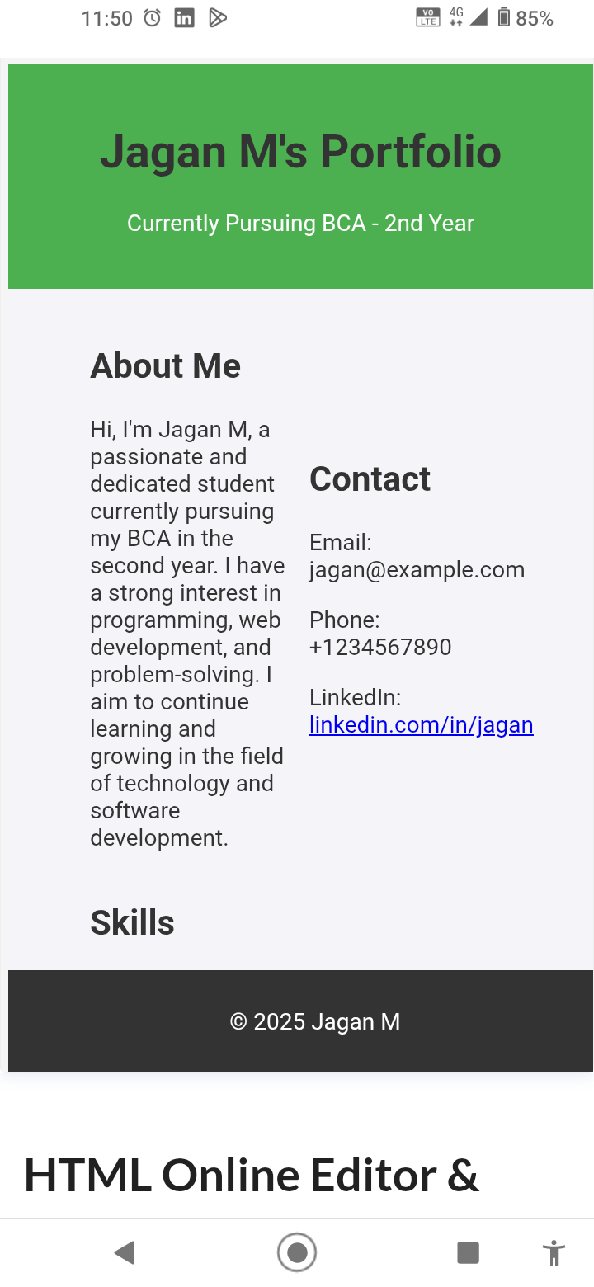
3/21/2024 Annual Review
‹#›

Slide 11
GitHub Link: https://github.com/13429bca2024-sudo

Slide 12
The project demonstrates practical application of HTML, CSS, and JavaScript.
Provides a professional platform for career growth and opportunities.
Future improvements: Add React features, animations, blog section, project gallery.
‹#›

